Slide 1
SEG APPLICATION PROJECT
UltraFLEXplus Digital: I8243 MCS-48 Input Output Expander

Slide 2
Agenda
1. Project Objectives
2. Prerequisites
3. Project Duration
4. Project Learning Outcomes
5. Provided Materials
6. Project Deliverables
7. Project Details
✓ DUT
✓ Test Lists
8. Recommended Project Work Plan

Slide 3
Project Objectives
Provide complete program development exposure including coding and debug.
Enable jump step learning to the common tests in digital device.
This project content focus on developing trainee‘s device test technique and identify the tests which are commonly used in most of digital devices.
This project provides the Trainee an opportunity to develop a Test Program using I8243 on UltraFLEXplus system and develop their confidence when they extend the knowledge to a more complex digital device.
Build the programming and debugging skills on UltraFLEXplus digital and power instrument.
Upon the completion of the project, the Trainee should have developed programming and debugging skills on UltraFLEXplus basic instruments.

Slide 4
2. Prerequisites
Before starting this project, the Student should have:
Completed the UltraFLEXplus Programming Fundamental Class
Knowledge on Project Management Process
Knowledge on ATE Fundamental

Slide 5
3. Project Duration
This program is conducted 1.5 weeks/ 8 days to meet the minimum requirement of the training objectives.

Slide 6
4. Project Learning Outcomes
At the end of the assignment, the engineer should have an understanding on the following:
UltraFLEXplus basic digital application project development
IGXL 10.xx
Debug tools and data collect
Digital device typical test items and trouble shooting skills

Slide 7
5. Provided Materials
Following materials will be provided, at the beginning of project:
Student handbook
Student Manual, PDF
Sample Schedule

Slide 8
6. Project Deliverables
Schedule (10/21, Wed)
Mid-Term Review(10/26, Mon)
15 mins for each trainee
Final Review (10/30, Fri)
1 hours/each trainee
Test Program
Data Collection
Datalog/ Test Time Profile
Wrap Up Presentation ( together with Mini project 2)

Slide 9
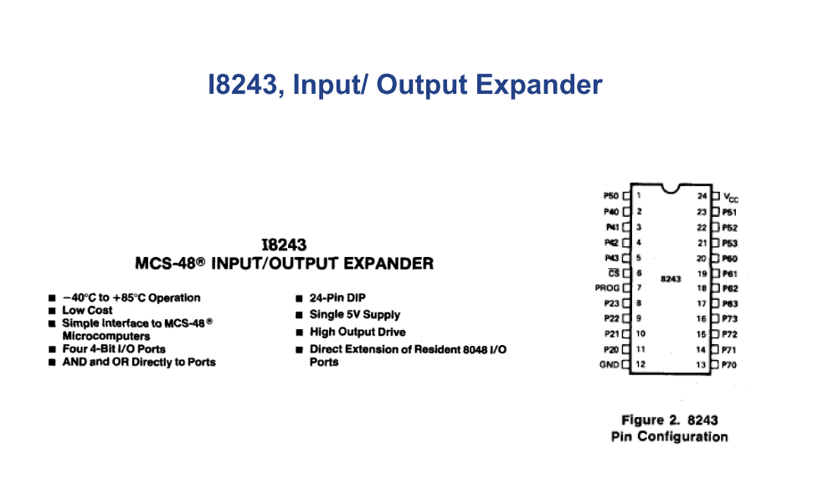
7. Project Details - DUT

Slide 10
7. Project Details - Test List
Shorts Test Using Dynamic Loads
Opens Test Using Dynamic Loads
Parametric Continuity Test
Static Icc Test
Input Leakage Test on port2 and control pins
Output tristate leakage on port4-7
Full Functional Test
Rise Time tests
Fall Time tests
Frequency Counter Test *

Slide 11
8. Recommended Project Work Plan
Go through this kick off slides and student manual
Review project materials.
Documentations
Schedule planning submited to mentor for feedback / approval before Main Work starts
System hours arrangement discussion for online debug
Progress updates with mentor for each 2-3 days
Before online debug, produce offline datalog without warnings/errors.
Online debug Test Program till achieve Bin 1.
Collect Datalog and Test Time Profile.
Perform necessary quality check
Review results with Mentor.

